Slide 1
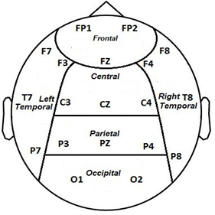
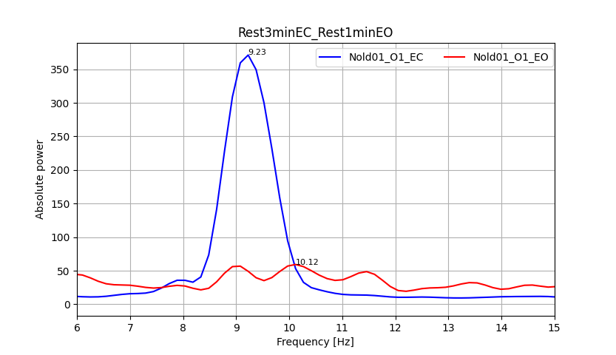
Nold01
This graph represents the channel with best reactivity of the Nold01 subject taking the signal recording in the resting state for eyes open and the signal recording in the resting state for eyes closed.

Slide 2
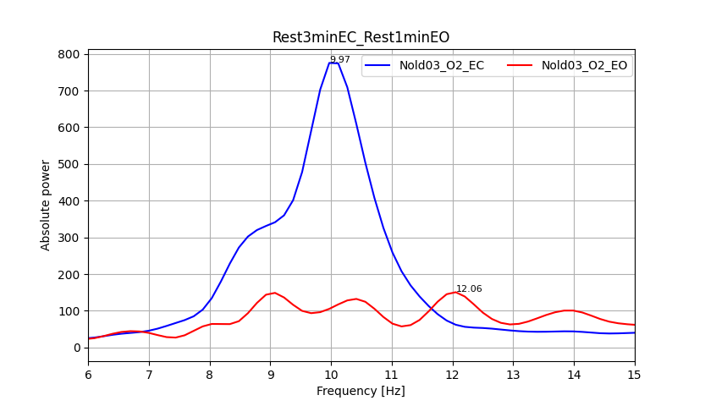
Nold03
This graph represents the channel with best reactivity of the Nold03 subject taking the signal recording in the resting state for eyes open and the signal recording in the resting state for eyes closed.

Slide 3
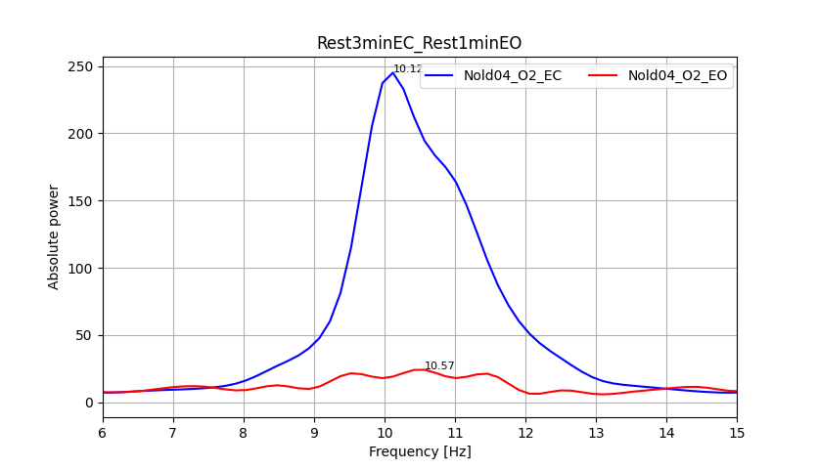
Nold04
This graph represents the channel with best reactivity of the Nold04 subject taking the signal recording in the resting state for eyes open and the signal recording in the resting state for eyes closed.

Slide 4
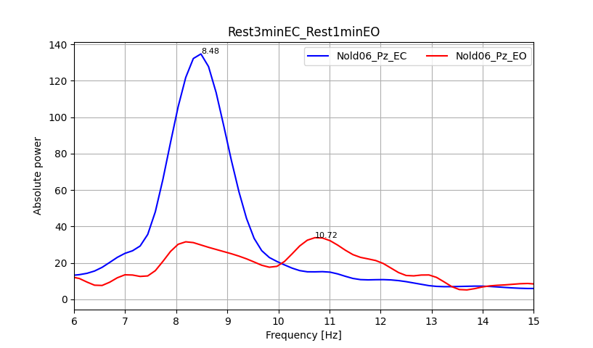
Nold06
This graph represents the channel with best reactivity of the Nold06 subject taking the signal recording in the resting state for eyes open and the signal recording in the resting state for eyes closed.

Slide 5
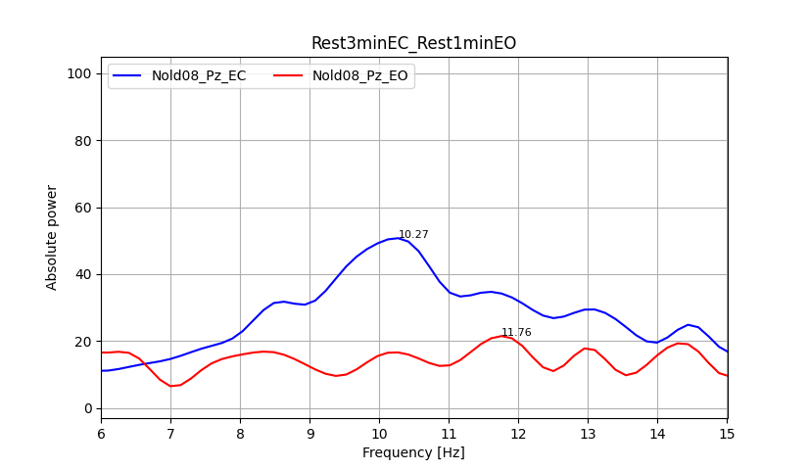
Nold08
This graph represents the channel with best reactivity of the Nold08 subject taking the signal recording in the resting state for eyes open and the signal recording in the resting state for eyes closed.

Slide 6
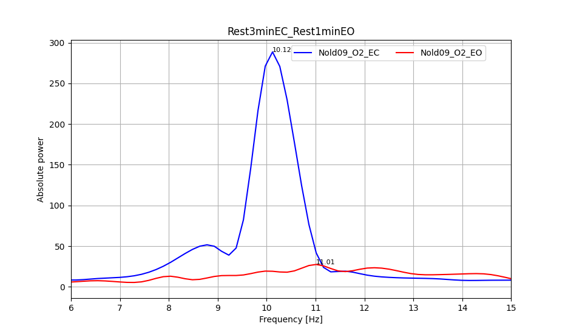
Nold09
This graph represents the channel with best reactivity of the Nold09 subject taking the signal recording in the resting state for eyes open and the signal recording in the resting state for eyes closed.

Slide 7
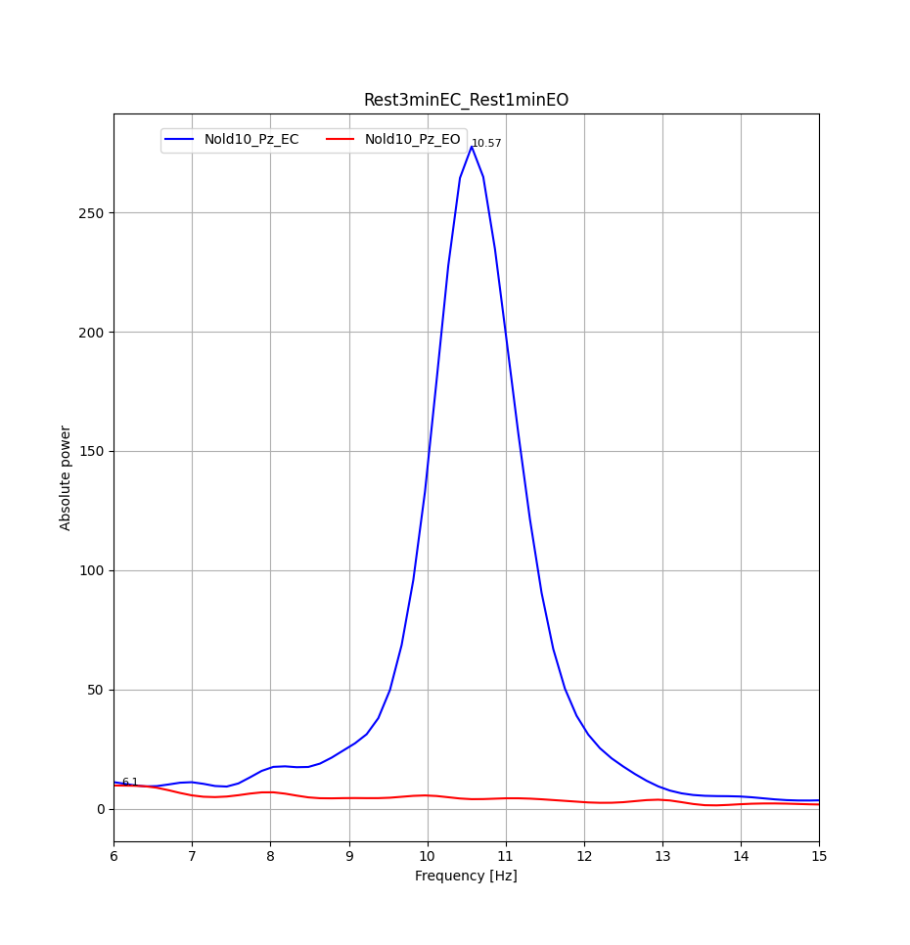
Nold10
This graph represents the channel with best reactivity of the Nold10 subject taking the signal recording in the resting state for eyes open and the signal recording in the resting state for eyes closed.

Slide 8
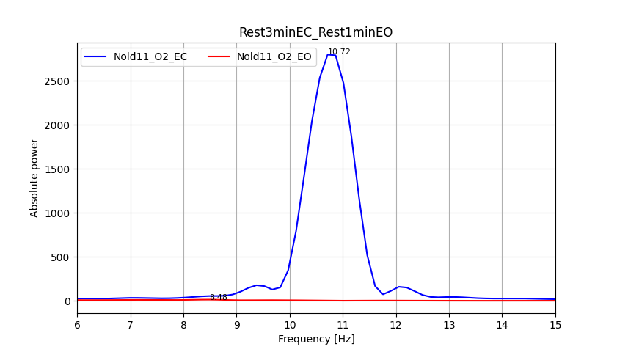
Nold11
This graph represents the channel with best reactivity of the Nold11 subject taking the signal recording in the resting state for eyes open and the signal recording in the resting state for eyes closed.

Slide 9
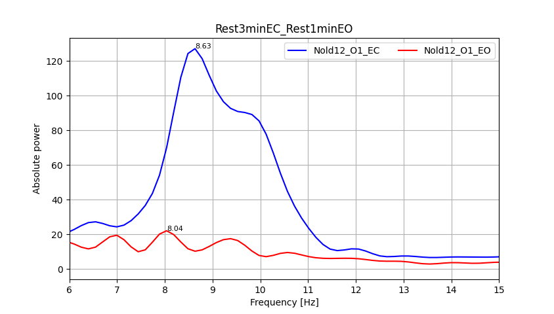
Nold12
This graph represents the channel with best reactivity of the Nold12 subject taking the signal recording in the resting state for eyes open and the signal recording in the resting state for eyes closed.

Slide 10
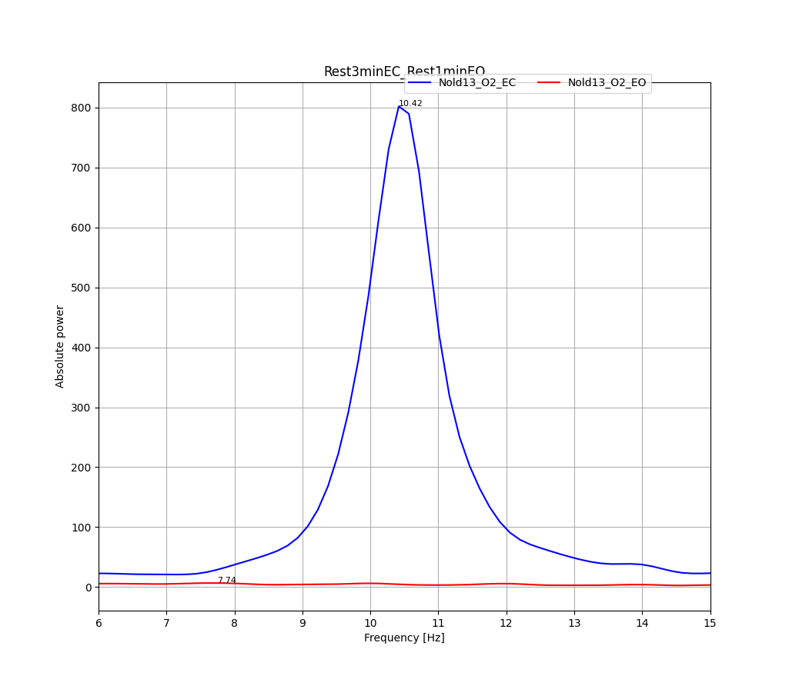
Nold13
This graph represents the channel with best reactivity of the Nold13 subject taking the signal recording in the resting state for eyes open and the signal recording in the resting state for eyes closed.

Slide 11
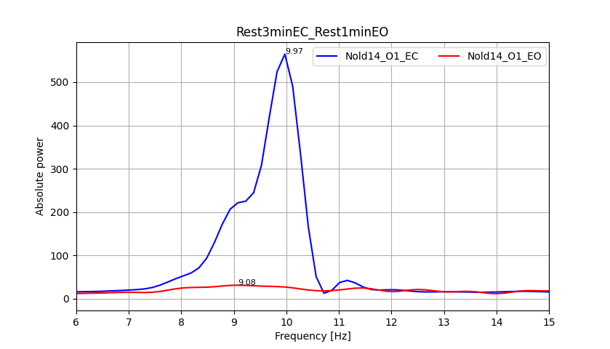
Nold14
This graph represents the channel with best reactivity of the Nold14 subject taking the signal recording in the resting state for eyes open and the signal recording in the resting state for eyes closed.

Slide 12
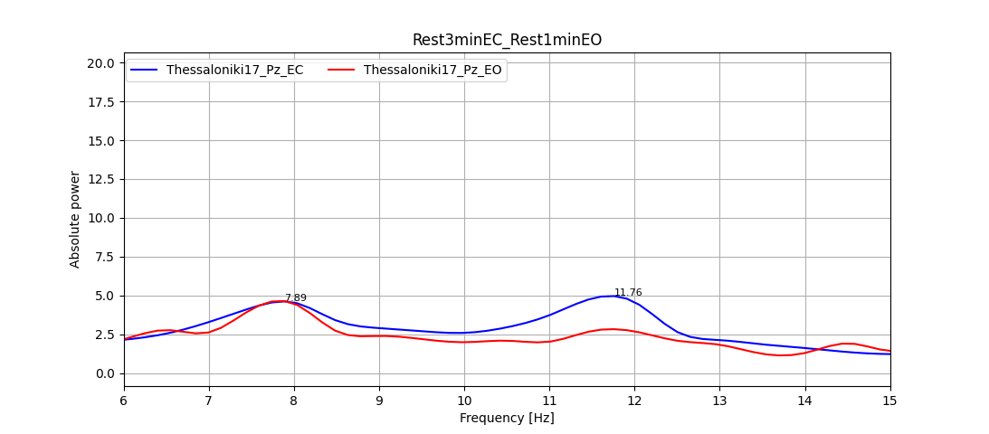
Thessaloniki17
This graph represents the channel with best reactivity of the Thessaloniki17 subject taking the signal recording in the resting state for eyes open and the signal recording in the resting state for eyes closed.

Slide 13
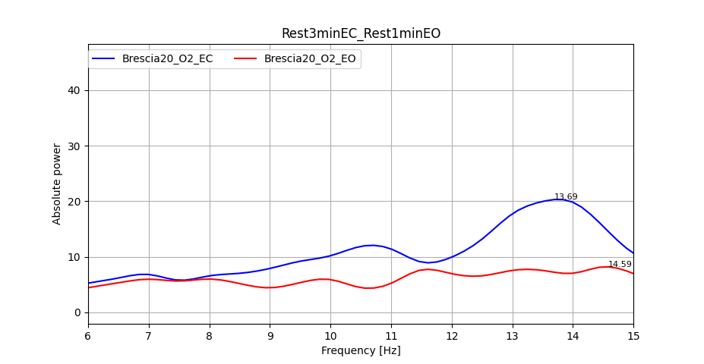
Brescia20
This graph represents the channel with best reactivity of the Brescia20 subject taking the signal recording in the resting state for eyes open and the signal recording in the resting state for eyes closed.

Slide 14
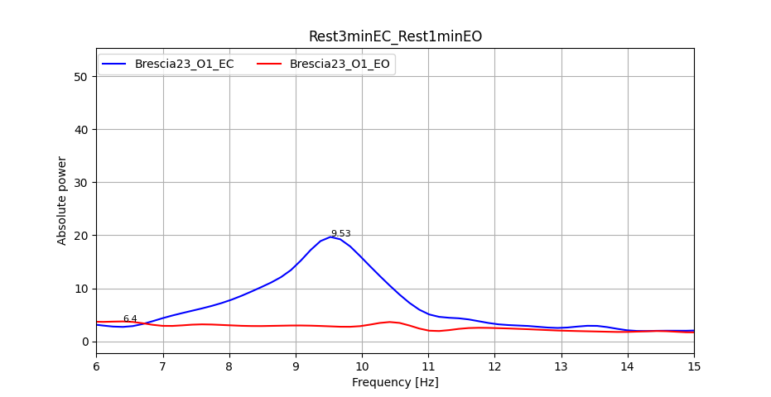
Brescia23
This graph represents the channel with best reactivity of the Brescia23 subject taking the signal recording in the resting state for eyes open and the signal recording in the resting state for eyes closed.

Slide 15
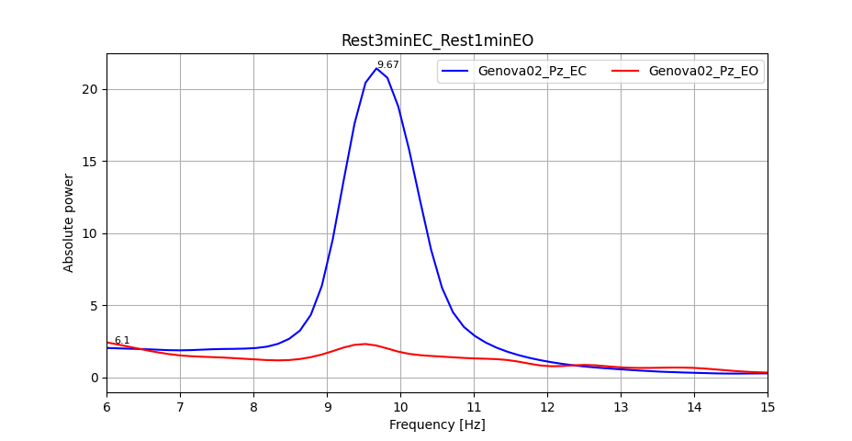
Genova02
This graph represents the channel with best reactivity of the Genova02 subject taking the signal recording in the resting state for eyes open and the signal recording in the resting state for eyes closed.

Slide 16
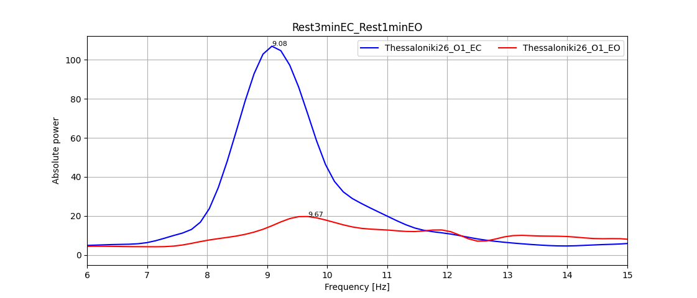
Thessaloniki26
This graph represents the channel with best reactivity of the Thessaloniki26 subject taking the signal recording in the resting state for eyes open and the signal recording in the resting state for eyes closed.

Slide 17
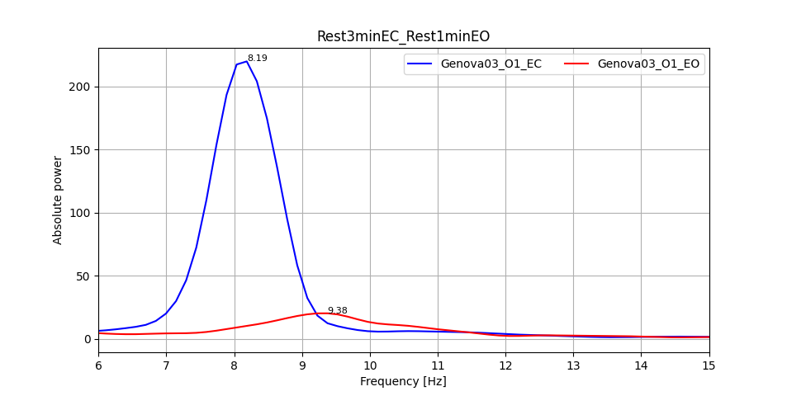
Genova03
This graph represents the channel with best reactivity of the Genova03 subject taking the signal recording in the resting state for eyes open and the signal recording in the resting state for eyes closed.

Slide 18
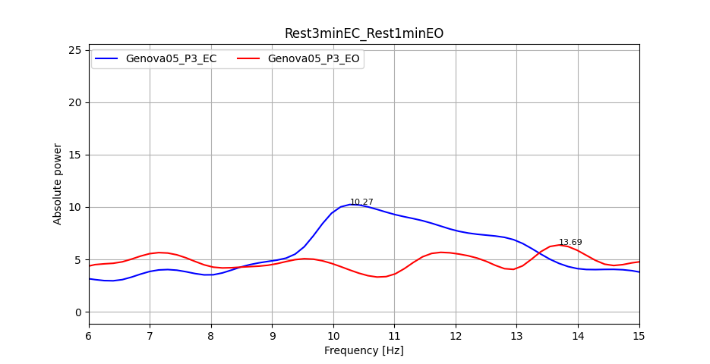
Genova05
This graph represents the channel with best reactivity of the Genova05 subject taking the signal recording in the resting state for eyes open and the signal recording in the resting state for eyes closed.

Slide 19
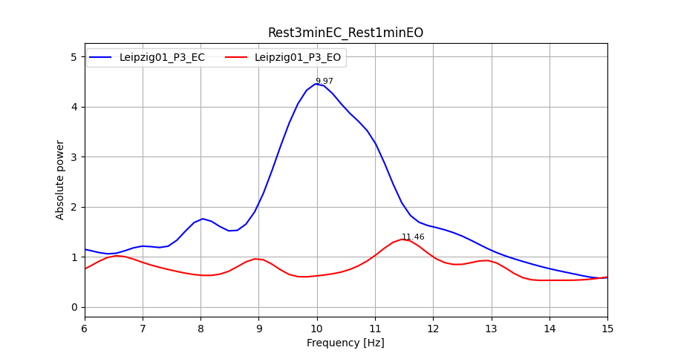
Leipzig01
This graph represents the channel with best reactivity of the Leipzig01 subject taking the signal recording in the resting state for eyes open and the signal recording in the resting state for eyes closed.

Slide 20
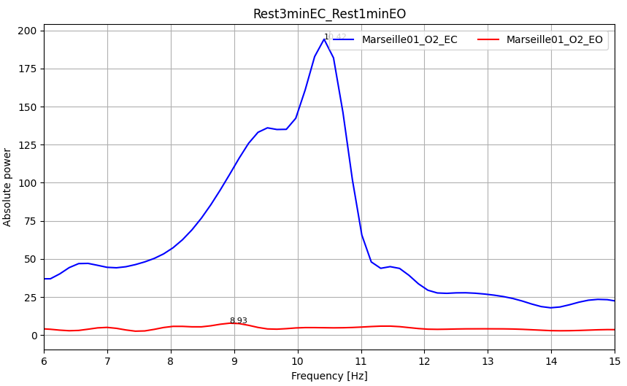
Marseille01
This graph represents the channel with best reactivity of the Marseille01 subject taking the signal recording in the resting state for eyes open and the signal recording in the resting state for eyes closed.

Slide 21
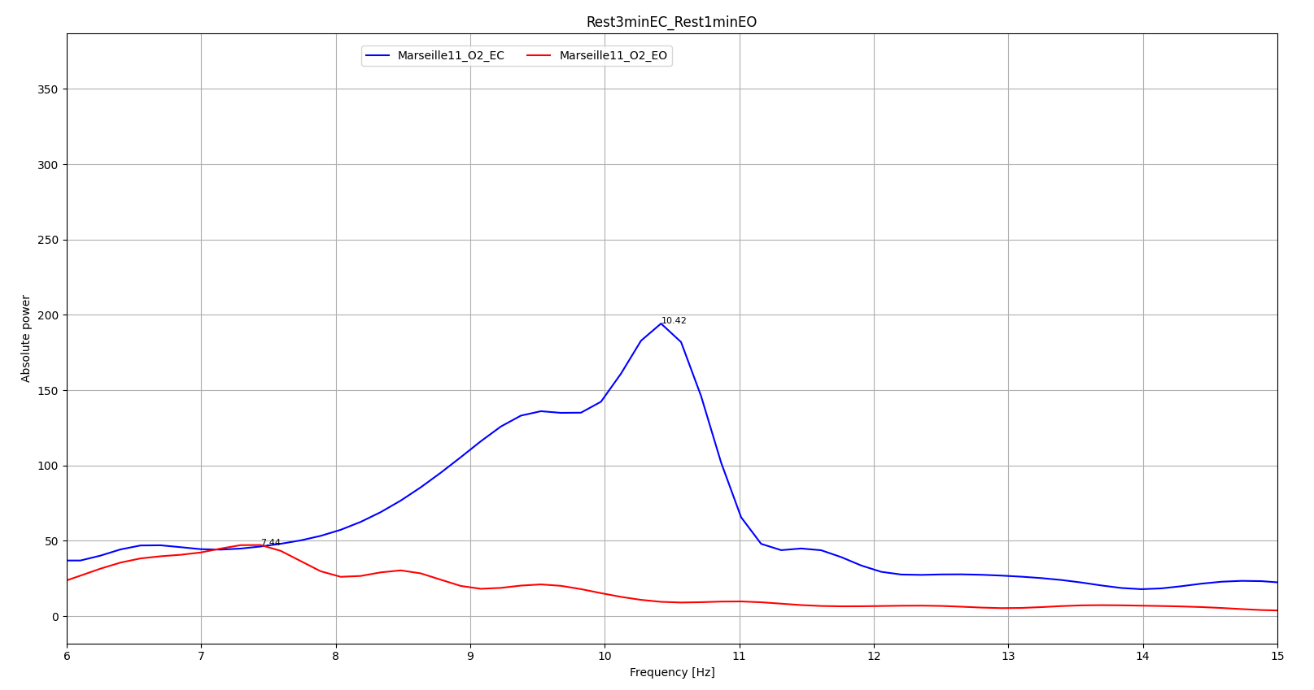
Marseille11
This graph represents the channel with best reactivity of the Marseille11 subject taking the signal recording in the resting state for eyes open and the signal recording in the resting state for eyes closed.

